Slide 1

Controlling Adult Contents for Under Aged
Project Presentation On Topic
Team: OTP
nileshnalini1234@gmail.com

Slide 2
What is the problem?
Young generation are the future of our country. This generation uses internet alot for their study purpose. While, in between searching they get such type of links which directs them to adult websites or contents which are not appropriate in their schooling age.

Slide 3
First of all, they changes their overall personality.
Their outlook/mentality for society and environment changes gradually over time.
Their mindset for every conditions thinks towards negativity.
They gets deviated from their aim.
They spoil their precious time of that age.
Their addiction towards such contents is increasing tremendously.
Schooling is age of base making and such type of content in life of students depleting their base.

Slide 4




Slide 5
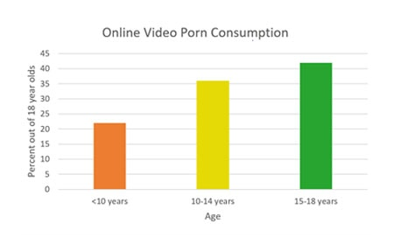

Slide 6
AFFECTED COMMUNITY
Under -aged students
society
Neighbouring community

Slide 7
How long you are working on this idea and why?
We are working on this idea for 10 days because this idea will help schooling students focus on their study and use their potential in right way and future of youth get enlightened.

Slide 8
WHETHER THE IDEA IS ORIGINAL OR DERIVED FROM SOME ESTABLISHED TECHNOLOGY OR PROCESS
OUR IDEA IN ORIGINAL

Slide 9
WHETHER THE SOLUTION IS STATE OF THE
Solution is state of the art

Slide 10
So, what should be the solution
Many experts believe this is due to two primary issues: mobile accessibility and desensitization at an earlier age.
Government should banned all the sites which containing such type of links.
Such type of sites should not be get opened directly without login, and the login should be based on age verification.
The age verification is processed by e-mail id.
Government should enforce the rule for all email providers to add an extra user’s aadhar card no. field for verification purpose.
When they direct to such sites they would be redirected to govt login page, which would further verify the current user is under-aged or not using their e-mail service providers which have their aadhar card number mentioned in their e-mails.
Through this solution we can stop under-aged students to stop opening adult contents sites.

Slide 11
What are the outcomes?
The under-aged students will not able to open adult contents any more, and they will spend their more time on study.
They

Slide 12

So, lets pledge to make our youth generation better.
Thank you

